Slide 1
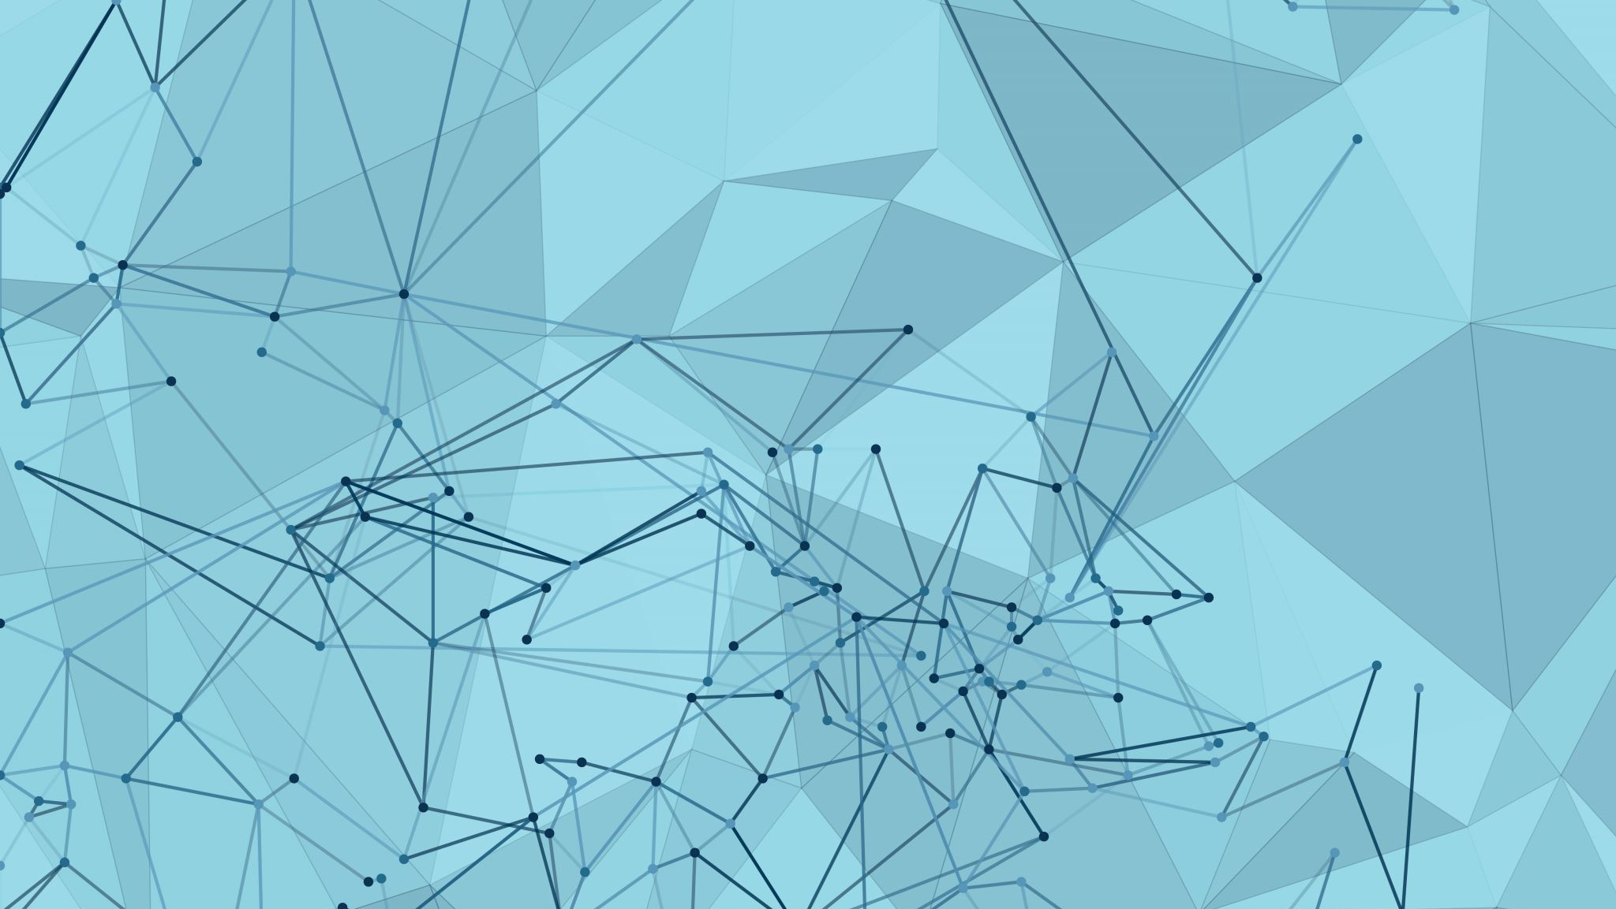
Tic Tac Toe Game
:Made by
Mohammed Adham El Sayed Ali Khaled Ali Noor Mostafa Saleh Nada Mohammed Ahmed
Supervised by:
Dr. Mahmoud Bassiouni

Slide 2
Overview
What is this project about?
Tic Tac Toe game implemented using Python and Streamlit.
Designed for both Player vs Player and Player vs Computer modes.
Interactive interface with a modern design.

Slide 3
Objectives
Create a fun and simple game accessible via a web browser.
Provide a learning experience for Streamlit and Python developers.
Showcase modular and reusable code structure

Slide 4
Key Features
Responsive design with styled buttons and feedback.
Easy to switch between game modes.
Minimalistic and clear user interface

Slide 5
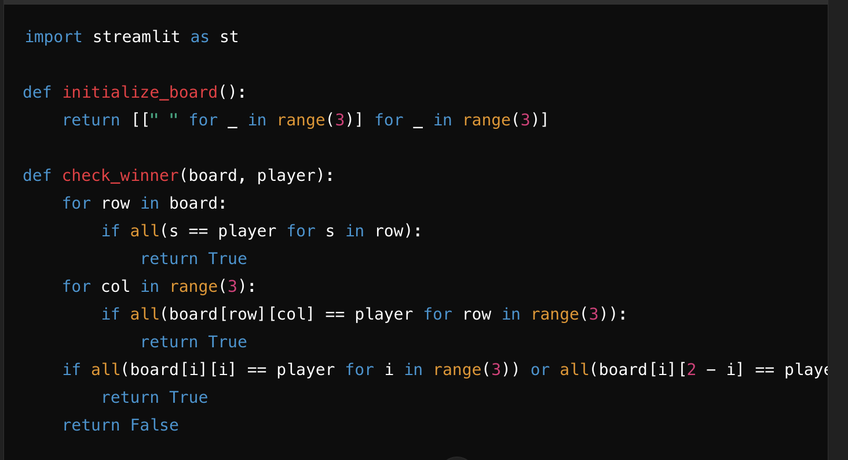
Basic Setup
Explanation:
initialize_board: Creates a 3x3 game board.
check_winner: Checks if a player has won via rows, columns, or diagonals.
These functions are used later to ensure game logic.

Slide 6
User Interface with Streamlit
The user interface was built using Streamlit, a platform that allows for easy and fast web application development. Users can upload an image through a simple interface, and the generated caption, translation, and audio are displayed directly.
The uploaded image appears on the left side of the screen.
The caption, translation, and audio are shown on the right side.

Slide 7
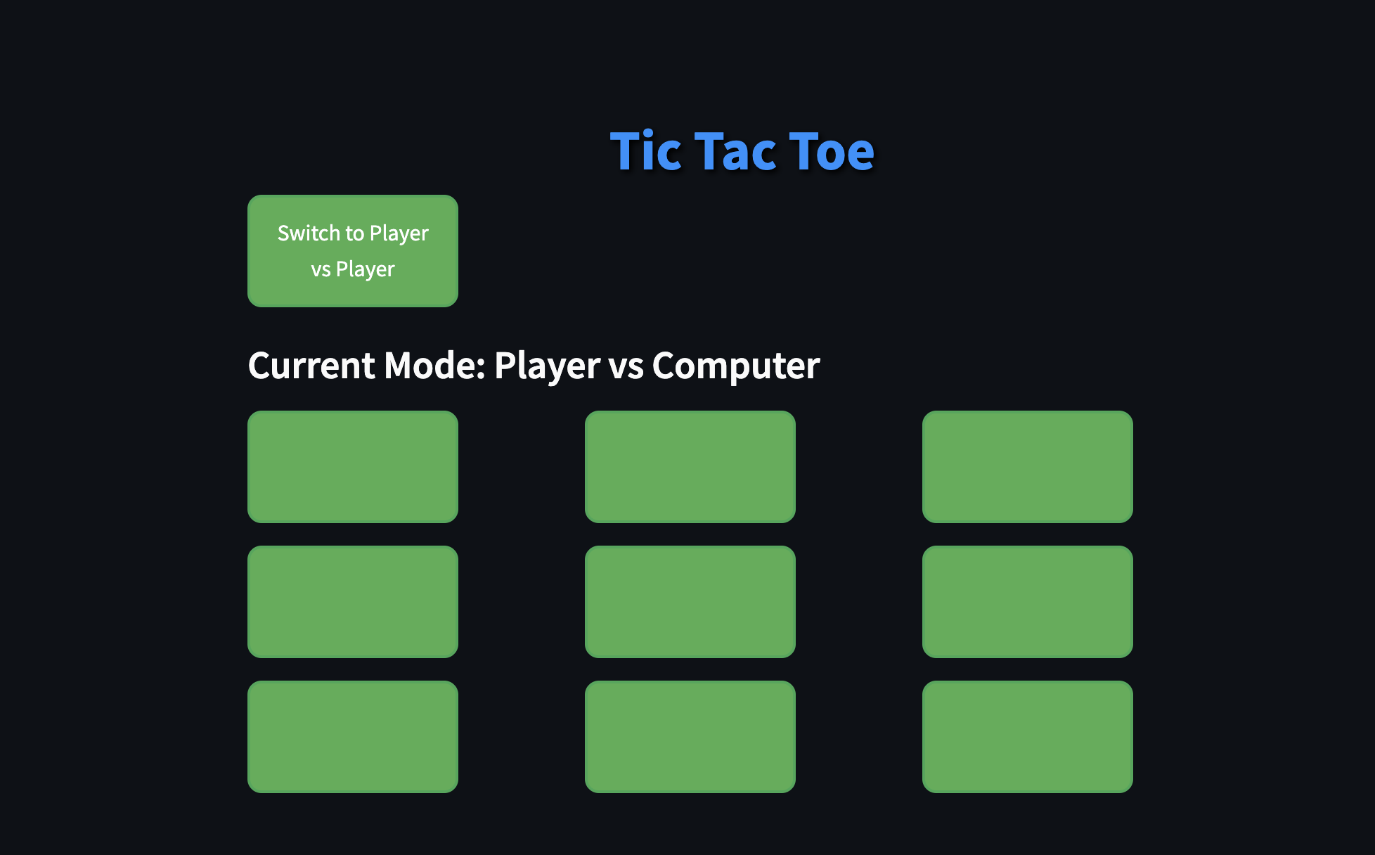
User interface

Slide 8
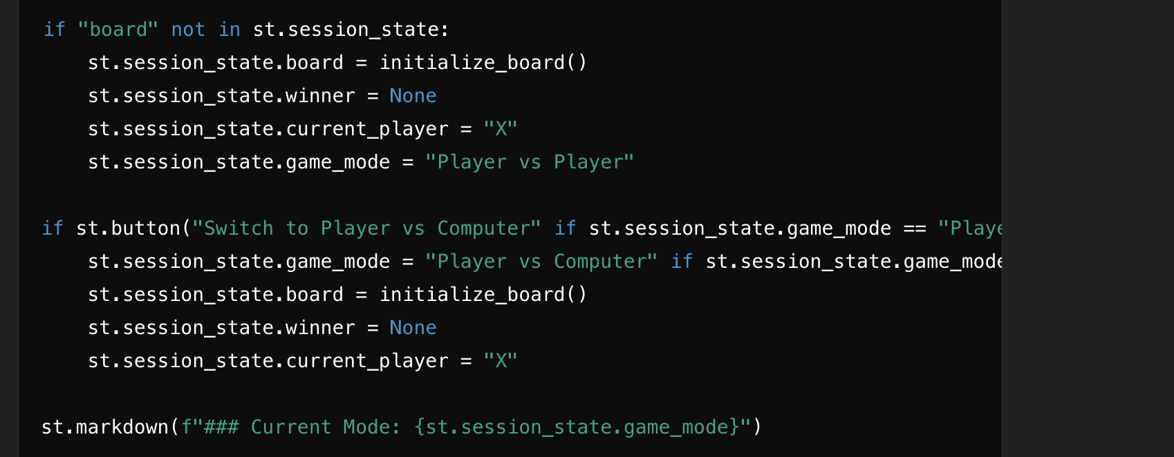
Game Logic
Explanation: st.session_state: Stores the game state, such as the board, current player, and game mode. A button allows switching between game modes: Player vs Player and Player vs Computer. Resets the board when switching modes.

Slide 9
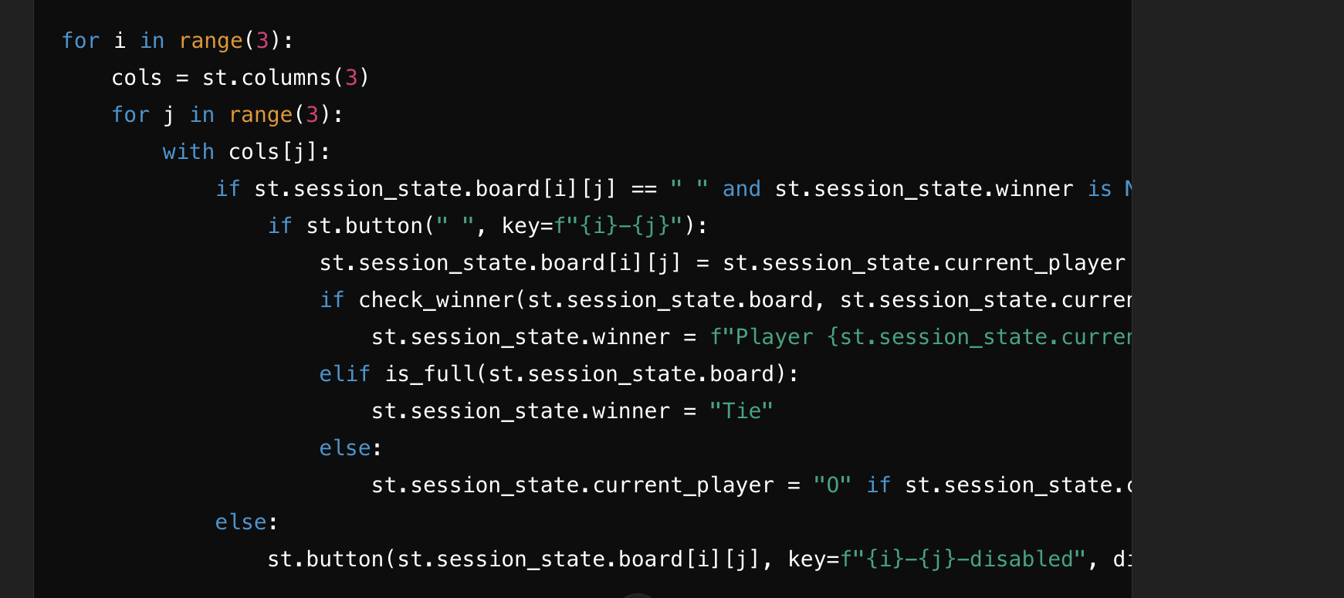
Game Interaction
Explanation:
Displays the game board as clickable buttons.
Checks the game state after each move to determine if there's a winner or tie.
Includes a "Restart Game" button to reset the game to its initial state.

Slide 10
Conclusion
The project demonstrates how to create a fully functional Tic Tac Toe game using Python and Streamlit.
It combines logic, interactivity, and design for a seamless gaming experience.
Key takeaways:
Python's flexibility for game development.
Streamlit's capabilities for building interactive web applications.
The importance of modular code for readability and maintainability.
Future enhancements could include:
Adding difficulty levels for the computer opponent.
Implementing user authentication for multiplayer gaming.
Improving the UI/UX with advanced styling.
This project serves as a foundation for exploring more advanced web-based applications.

Slide 11


